Slide 2
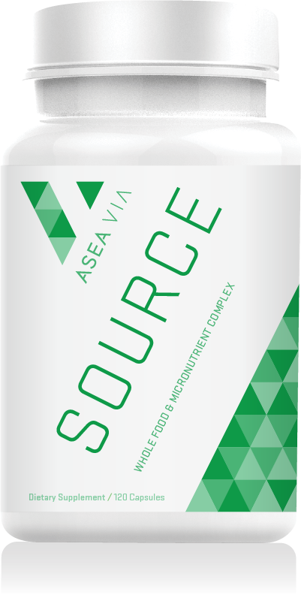

Slide 3
What is ASEA VIA Source?
ASEA VIA Source is a whole food micronutrient supplement containing vitamins, minerals, phytonutrients, organic super-foods, trace minerals and enzymes working together to support cellular health and general wellness.

Slide 4
The ASEA VIA Source Story
Source of the ingredients
Formulated to complement
ASEA REDOX
Absorption and bio-availability

Slide 5
The ASEA VIA Source Story
Our bodies assimilate whole-food sources of nutrition better than synthetic sources because whole foods contain key vitamins along with their cofactor, other nutrients naturally found in food that work with each vitamin to increase its absorption.
Vitamins in nature don’t stand alone.
They are present along with trace minerals, phytonutrients, and other vitamins in
combinations the body recognizes as nutrition.
Nutrients in VIA Source are based on
whole-food sources

Slide 6
The ASEA VIA Source Story
VIA Source has been expertly formulated to work in tandem with ASEA REDOX.
VIA Source features ASEA’s patented BioAmplify™ Absorption Complex,
which delivers the necessary
components to ensure maximum bioavailability and absorption of all nutrients found in VIA Source.

Slide 7
Key Features and Benefits
Provides the nutrient building blocks that work synergistically with ASEA REDOX.
Nutrients derived from whole food sources.
Includes vitamins and minerals in a glycoprotein ferment, a process that converts nutrients into a protein
matrix through natural fermentation,
making vitamins and minerals more
stable and bioavailable.

Slide 8
Key Features and Benefits
Includes both macro and trace marine minerals from red algae, a unique plant source that is more bioavailable than minerals derived from other sources.
Contains certified organic superfoods—a combination of nature’s most nutrient-dense greens and berries—guaranteeing maximum phytonutrient content and preserving those nutrients through a low-heat drying process.

Slide 9
Key Features and Benefits
Contains B vitamins extracted from holy basil, lemon, and guava, which are then naturally concentrated through a proprietary fermentation process that helps support the activity and stability of B-complex vitamins.
Contains organic trace minerals from an ancient plant source that has not been subjected to modern farming techniques. Because these minerals are in a pristine form, they are rich in nutrients not
found in the typical western diet.

Slide 10
Key Features and Benefits
100% vegan
Non-GMO
Gluten-free
100% plant cellulose capsules

Slide 11
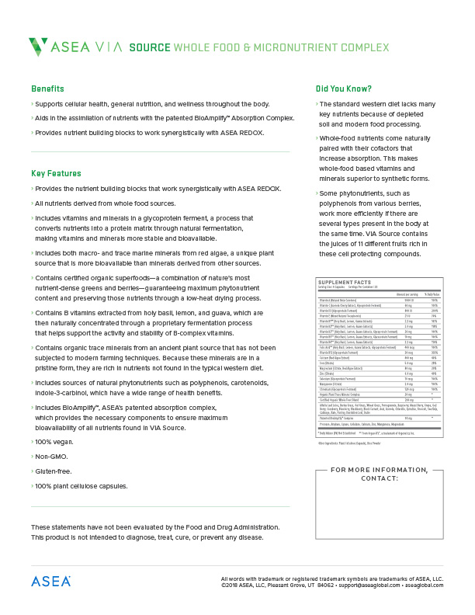
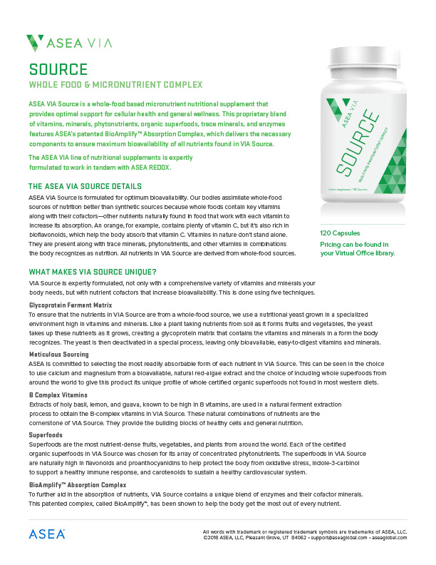
Product Information Page
Available in back office on March 16

Slide 12
Pricing
$55 USD
45 PV

Slide 13
Pre-release availability
Available for Associates and Preferred Customers on March 16
Shopping cart
Autoship
Al-a-carte enrollment
No enrollment packs or LRP
until September launch

Slide 14
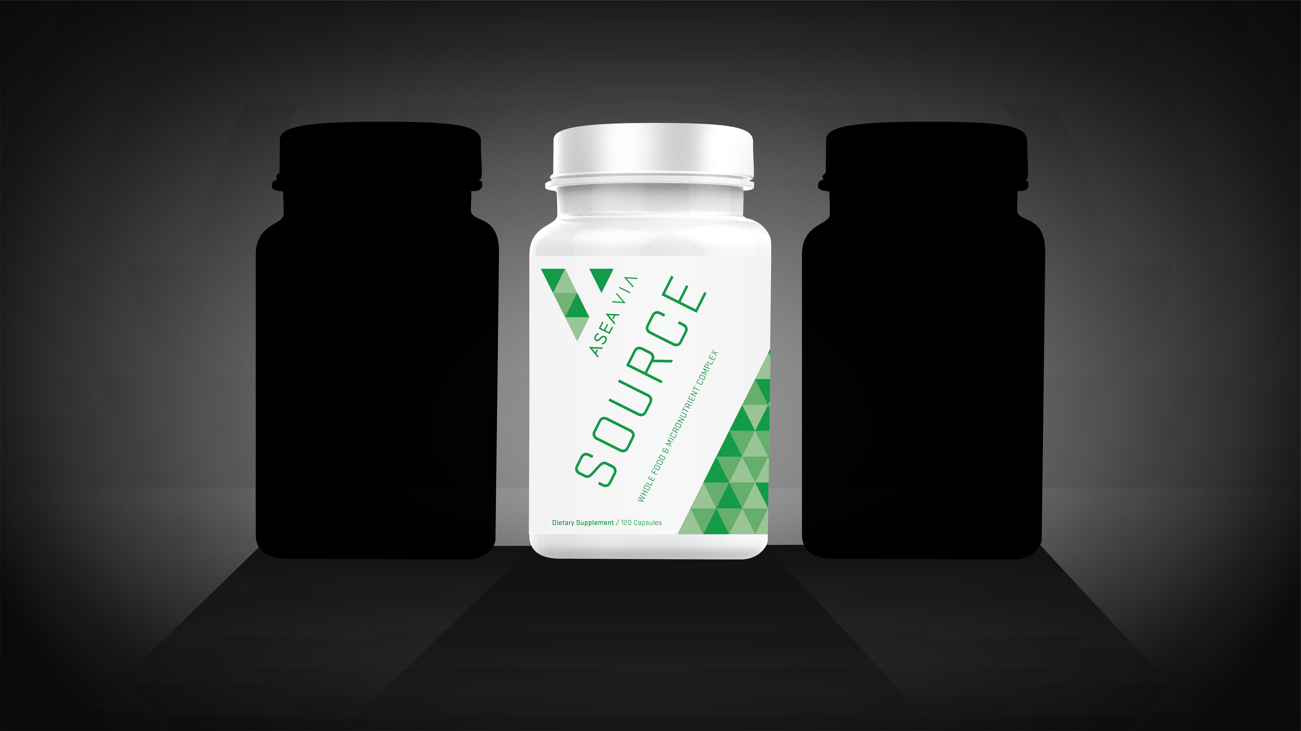
??
??
Launching at Convention 2018

Slide 15
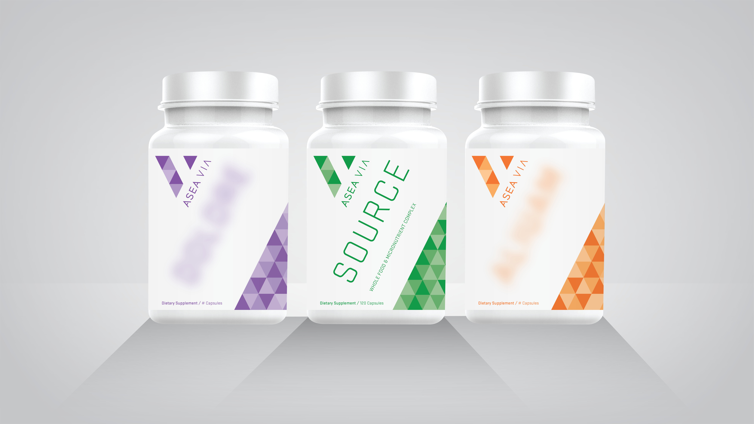
Full spectrum probiotic
Whole food
micro-nutrient complex
Cellular longevity complex

Slide 16
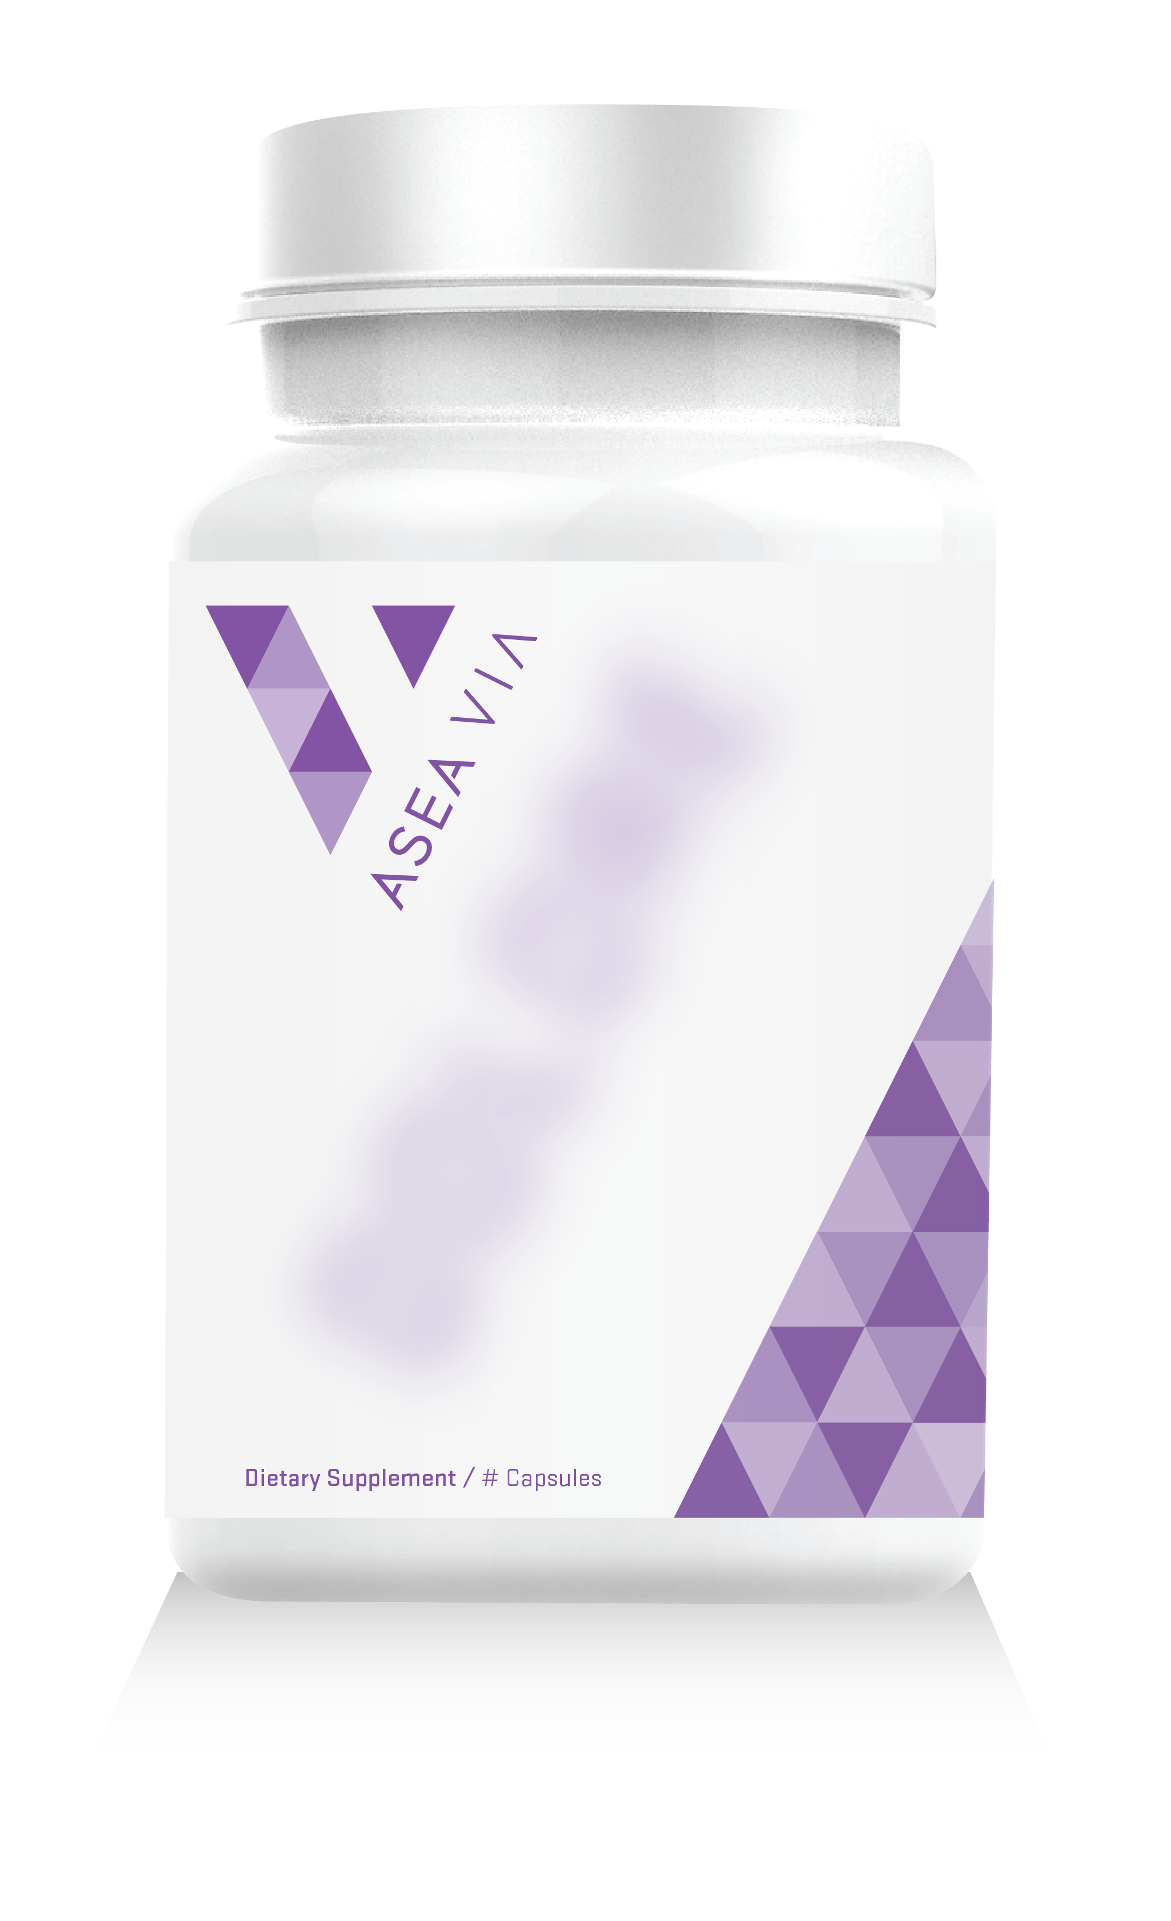
Full Spectrum Probiotic
Helps re-populate the body with healthy intestinal flora to aid in digestion
A healthy biome can help improve mood, support healthy immune function, and promote digestive health
Features an un-precedented 16 probiotic strains, as well as prebiotics that help support a healthy gut flora

Slide 17
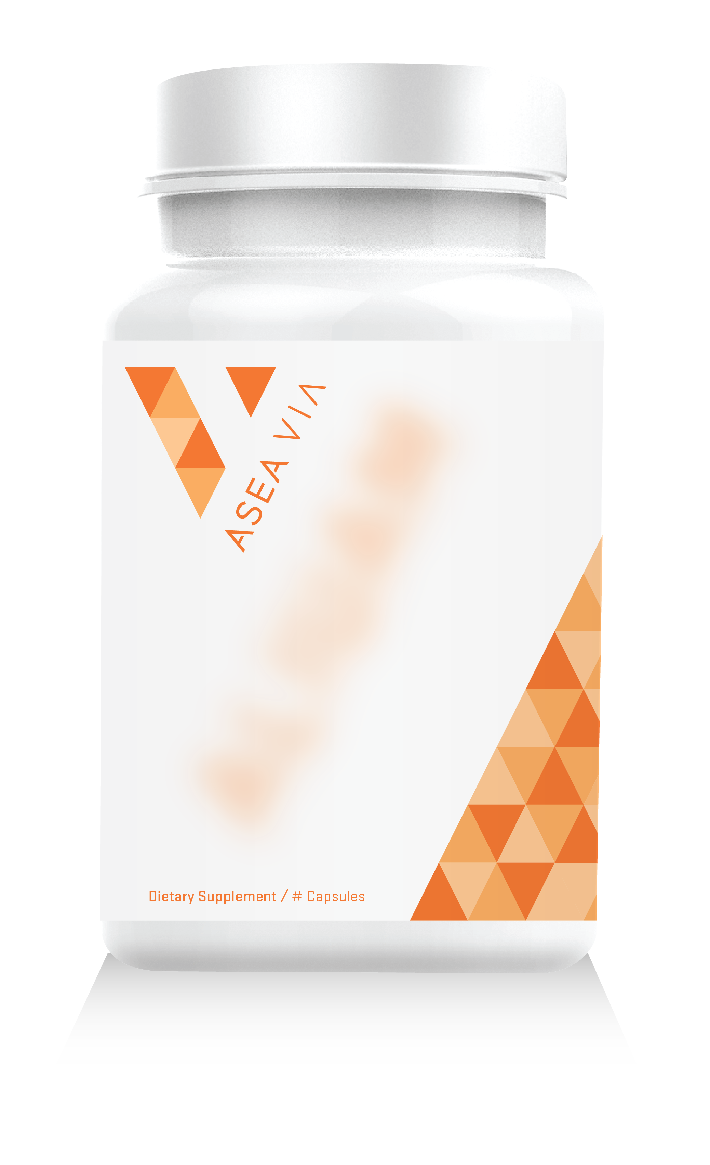
Cellular Longevity Complex
Attacks the effects of aging at the cellular level, promotes vitality and boosts the immune system.

